Slide 1
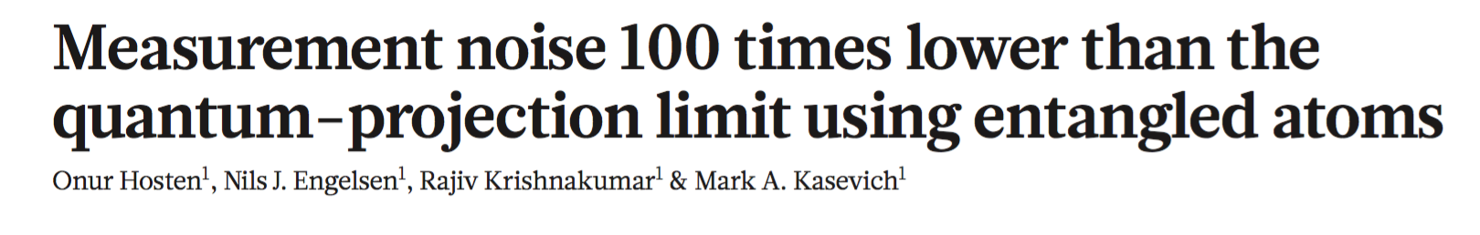
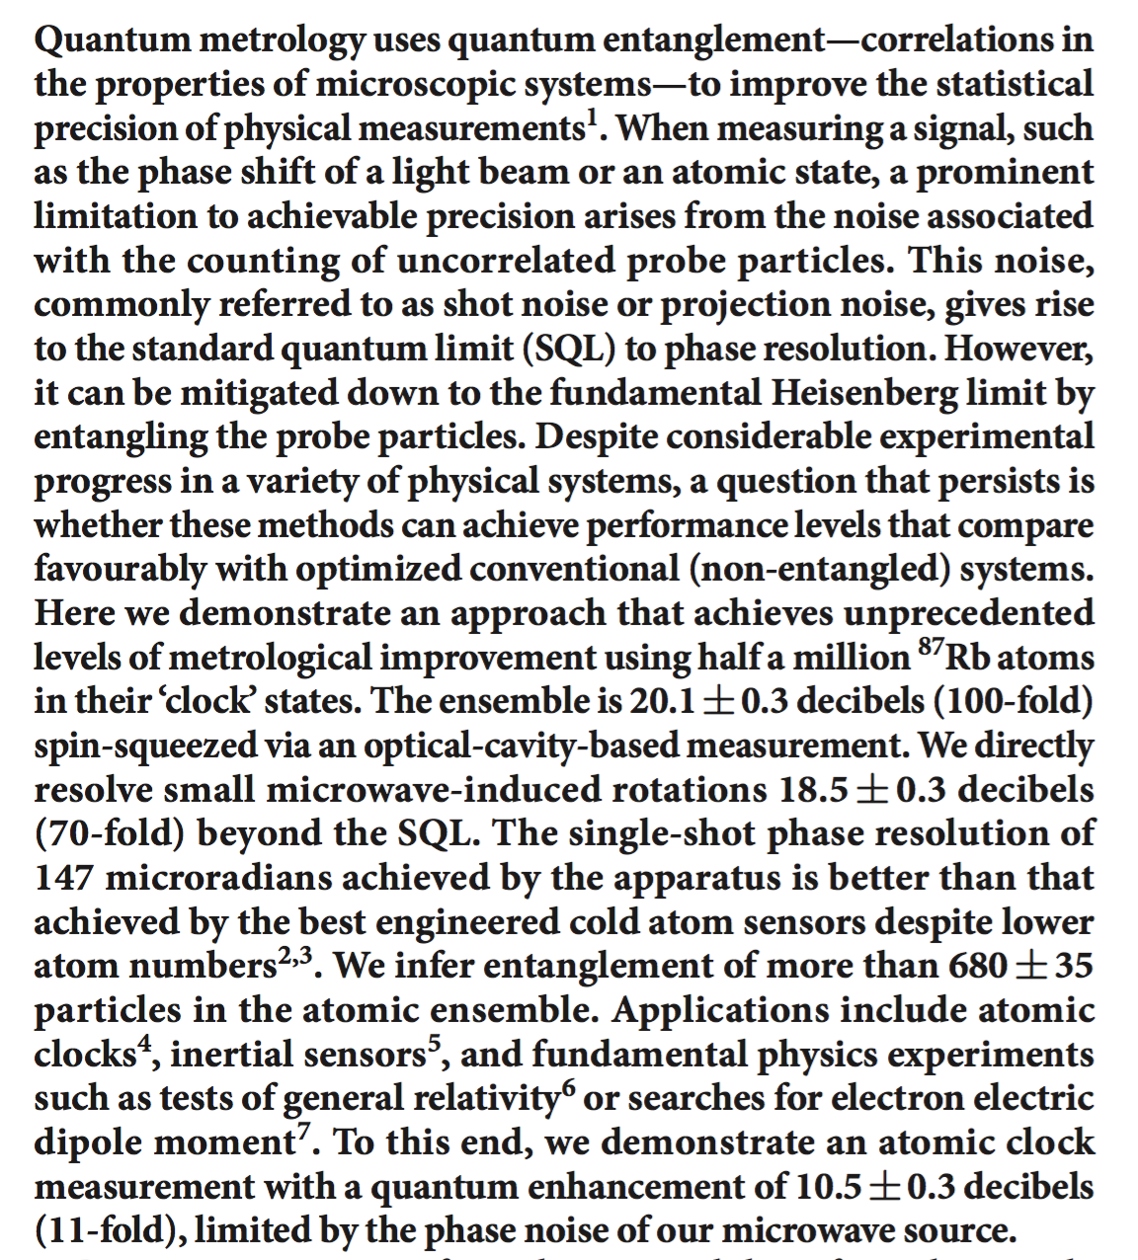
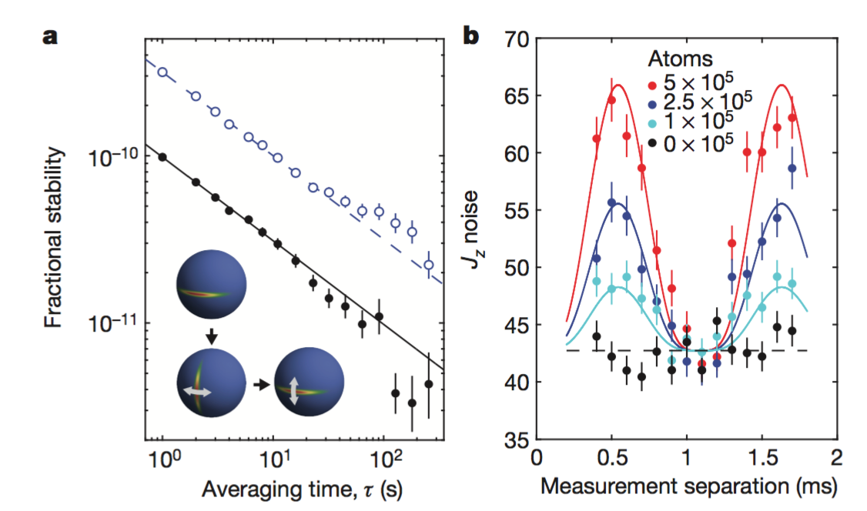
Presenter:
Daniel Schussheim

Slide 2
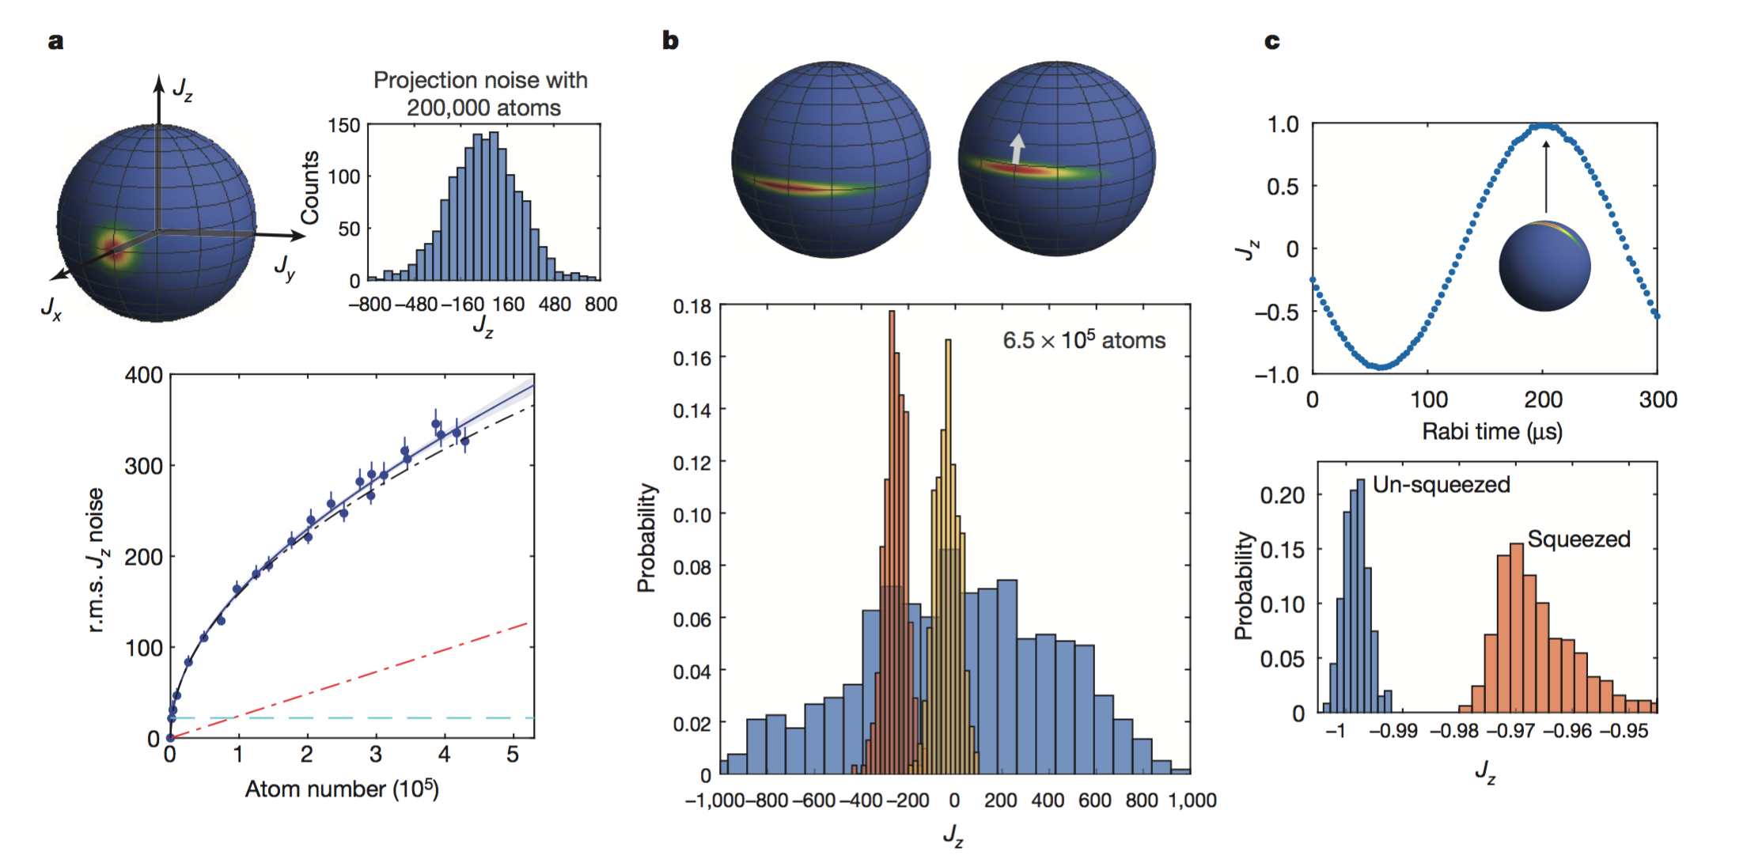
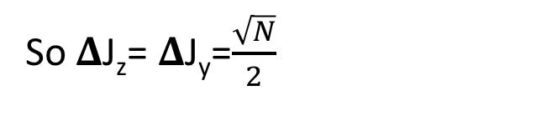
Squeezed states
N two-level atoms → spin J system, J=N/2 (each atom is spin-1/2)
Conjugate observables J_{x,y,z} obey 𝚫J_{z} 𝚫J_{y} ≥|J_{x}/2|
Non-entangled coherent spin state with 〈J_{z}〉=0=〈J_{y}〉
So 𝚫J_{z}= 𝚫J_{y}=$\frac{\sqrt{N}}{2}$
Entangled particles can reach Heisenberg uncertainty limit
Squeezing redistributes uncertainty, quieter than coherent state on one component
Degree of squeezing quantified by ${χ }^{2}={\left(\frac{\sqrt{N}/2}{ΔJ_{z}}\frac{\left|J_{x}\right|}{N/2}\right)}^{2}$
Notes:
First factor in chi-squared is noise reduction, second is coherence loss [reduction in Ramsey fringe] (average length of J vector shorter with larger spread)
chi-squared=100 (20 dB) equivalent to 100 times increase in atom number or averaging time
Upper bound in squeezing in this experiment 24 dB

Slide 3
Previous work
Optical interferometers
Superconducting microwave circuits
Squeezing demonstrated in:
Enhanced atomic clock and magnetometer stability
Improved micro-particle tracking in cells
Cavity based experiment with ⁸⁷Rb gave 10 dB metrological improvement
Utilized cycling transitions on magnetically sensitive states
Non-uniform coupling to cavity → not good for precision sensors
Noise reduction using entangled particles, until now, not at competitive performance levels compared to non-entangled systems
Notes:
Optical interferometers and sc microwave circuits reached 12 dB squeezing
Cold atom experiments reach sensitivity limit at high atom numbers (interaction shifts)
“Squeezing offers a universal path to surpassing this limitation to sensitivity”

Slide 4
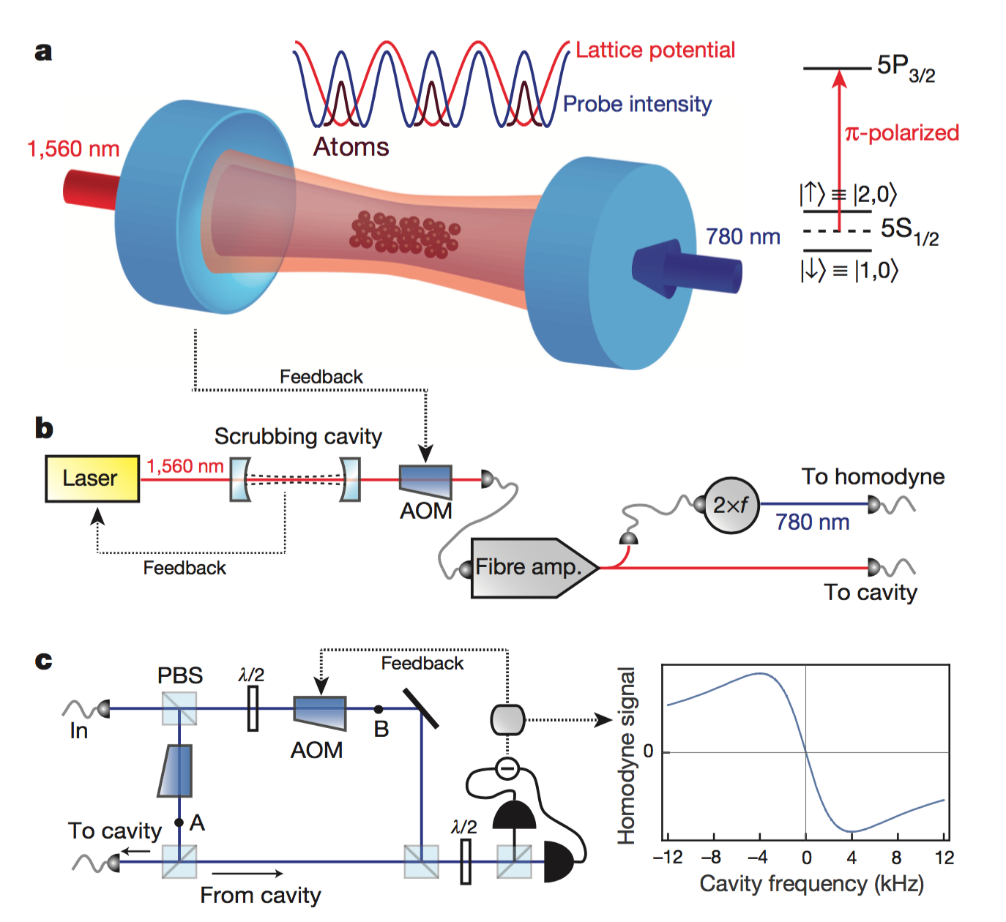
Squeezing through collective population difference measurement (J_{z} measurement)
Homodyne measures cavity frequency shift ∝ n∝ J_{z}
Stable to cavity shifts to 3 spin flips (5.5Hz/flip)
Atoms in 1D 1560 nm lattice (520 µK - depth), 780 nm probe
25 µK atoms (N = 7*10^5) in lower clock state
10.7 cm near-confocal cavity
ℱ = 1.75*10^5 (𝛾 = 8 kHz)
Notes:
455 Hz osc frequency
Quantum non-demolition measurement
Uniform coupling: claims squeezing info still obtainable if released from lattice (needed for cold atom sensors)
Cavity parameters: load 25 µK atoms (up to 7*10^5) in lower clock state, 10.7 cm near confocal cavity, finesse = 1.75*10^5 (linewidth 8 kHz)
Scrubbing cavity narrows linewidth of master laser (ECDL according to website)
1560 nm locked to main cavity resonance
780 has ~8Hz rms stability
Stable to cavity shift from 3 spin flips (1 is 5.5 Hz)
(Path B) LO for homodyne 80MHz shifted from input, kill 1/f noise for photon shot noise limited detection (10Hz-5MHz)
(Path A)
10 nW each in 78, 82MHz sidebands.
travel to the cavity and promptly reflect back from the first mirror to give a heterodyne beat-note signal (2 MHz) at the detectors
This signal is used to stabilize the interferometer path lengths via feedback onto the AOM on path A
Stabilization covers DC-15kHz “removing the influence of optical phase noise for the squeezing measurements”
Population difference changes index of refraction → shifts cavity frequency (down shifts up, etc.)
$∆ν=D\int{s\left(t\right)ρ\left(t\right)dt/\int{ρ^{2}\left(t\right)dt}}$ [D] = Hz/V, rho temporal signal shape (measure homodyne signal, no atoms, slightly off resonance)
Jz resolution determined by competition between photon shot noise and probe-induced Raman scattering (spin flips) (former limits precision of cavity f measurements, latter leads to random walk in measured observable)

Slide 5
Bring states to equator with π/2 (π/2₀ – π_{2π/3})
Squeezed states, higher J_{z} resolution
J_{z} distributions at lowest point in osc.
Notes:
Special π/2 sequence suppresses microwave pulse amplitude noise
Dot dashed is expected, solid is fit, revealing microwave rotation noise (straight dot dash), bottom dashed line is resolution of π strength measurement
Balanced population difference → 2% rms number fluctuation does not come in at measurable level
200 µs shortest without significant ringing on homodyne
b shows squeezed distribution, and one rotated 660µrad by a microwave pulse, much better Jz contrast compared to CSS
c is 96.2% contrast Rabi oscillations of squeezed state (fluorescence imaging)
Bottom is Jz distributions at lowest point of Rabi oscillation

Slide 6
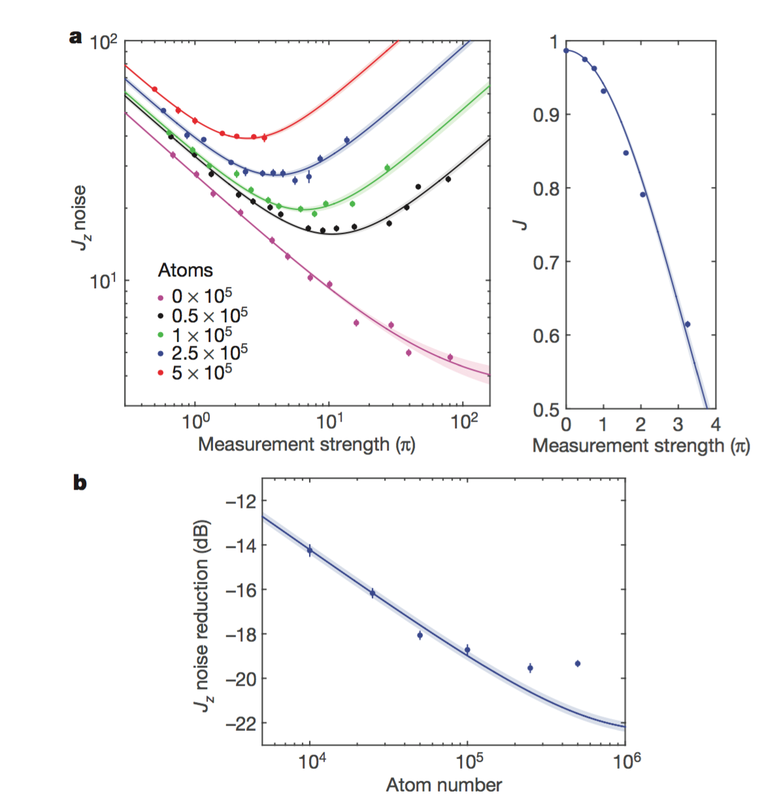
Measurement strength: “amount of differential phase shift accumulated on clock states due to probe induced AC Stark shifts”
States deterministically pre-squeezed by 7 dB, 99% coherence (to remain within linear region of homodyne)
Largest noise reduction 20.1(3) dB at 5*10⁵ atoms
Notes:
Presqueezing with Jz^2 interaction (to stay within linear region of homodyne)
“we obtain the same final squeezing results in the absence of pre-squeezing if we post-select the runs with the first measurement outcome lying within the linear regime of the homodyne signal"
Presqueeze with Jz^2 interaction, put detuned probe light into cavity, different shift for atoms in upper or lower state, fixed incident power → Jz dependent intracavity power, leads to “shearing” of coherent state ellipse
“We send 100 nW of light at 6.25κ0 detuning from the bare cavity resonance (generating Jz^2 interaction) and simultaneously
turn on a 400 μs microwave π/12 pulse (generating rotations around the Jx axis)”
Outside linear region measurement efficiency and intra-cavity probe power decrease.
These figures are to show that the Jz measurement prepares a state with reduced Jz noise
Jz noise on 2 equal strength back to back measurements (at optimal measurement separation)
0 atoms is noise floor
Right is mean length, J (coherence), of Bloch vector
Ramsey fringe contrasts on first measurement
Bottom figure is relative to CSS noise
States contain 3dB more squeezing than directly observed due to uncorrelated noise in second measurement

Slide 7
Application: atomic clock
10.5(3) dB metrological gain
18.5(3) dB improvement on small microwave rotations
Single shot phase resolution 147 µrad
b, noise in back to back measurements, due to thermal motion
Notes:
228 µs interrogation (largest Ramsey time that does not measurably degrade comparison), 1 Hz rep rate
π/2 74µs for phase sensitive rotation
Reaches given precision 11.2(8) times faster than without squeezing
Second figure related to sensors that need to release atoms and perform a fluorescence measurement
To infer the retriev- able squeezing in a configuration where the second cavity measurement is replaced with fluorescence imaging in free space, we analyze the noise modulations observed in back-to-back cavity measurements (Fig. 4b) as a function of delay time between the measurements.
Measurement separations between two successive measurements of Jz
Modulation only in noise measurement, not population difference measurement
These modulations are evidently due to residual atom–probe coupling inhomogeneities
Residual thermal motion
noise is smallest when the separation is half-integer multiples of the 2.2 ms transverse-oscillation period (455Hz)
Anticipate 14.6
Single shot phase resolution better than best cold atom sensor despite lower atom numbers

Slide 8
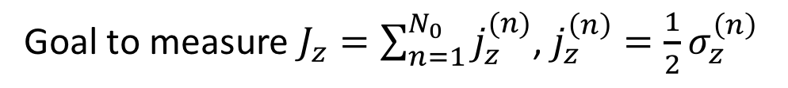
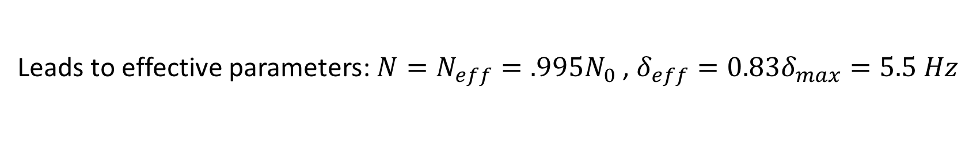
Coupling inhomogeneity
Goal to measure $J_{z}=\sum_{n=1}^{N_{0}}{j_{z}^{(n)}}$, $j_{z}^{\left(n\right)}=\frac{1}{2}σ_{z}^{\left(n\right)}$
Because of atom-cavity inhomogeneity, actually measure $J_{z}^{′}$, weighted sum of${ j}_{z}^{\left(n\right)}$
If all atoms coupled identically, total frequency shift is $Δ_{0}=\sum_{n=1}^{N_{0}}{δ_{0}j_{z}^{(n)}=δ_{0}J_{z}}$
Inhomogeneity gives slight shift, $ε_{n}$, to each atom, n
Measured shift is $∆=\sum_{n=1}^{N_{0}}{δ_{0}\left(1−ε_{n}\right)j_{z}^{\left(n\right)}=δ_{0}Z\left(\frac{1}{Z}\sum_{n=1}^{N_{0}}{(1−ε_{n})j_{z}^{\left(n\right)}}\right)≝δ_{eff}J_{z}^{′}}$
Leads to effective parameters: ${N=N}_{eff}=.995N_{0}$ , $δ_{eff}=0.83δ_{max}=5.5 Hz$
Notes:
Choose Z so var(Jz)/max(Jz) = var(Jz’)/max(Jz’)

Slide 9
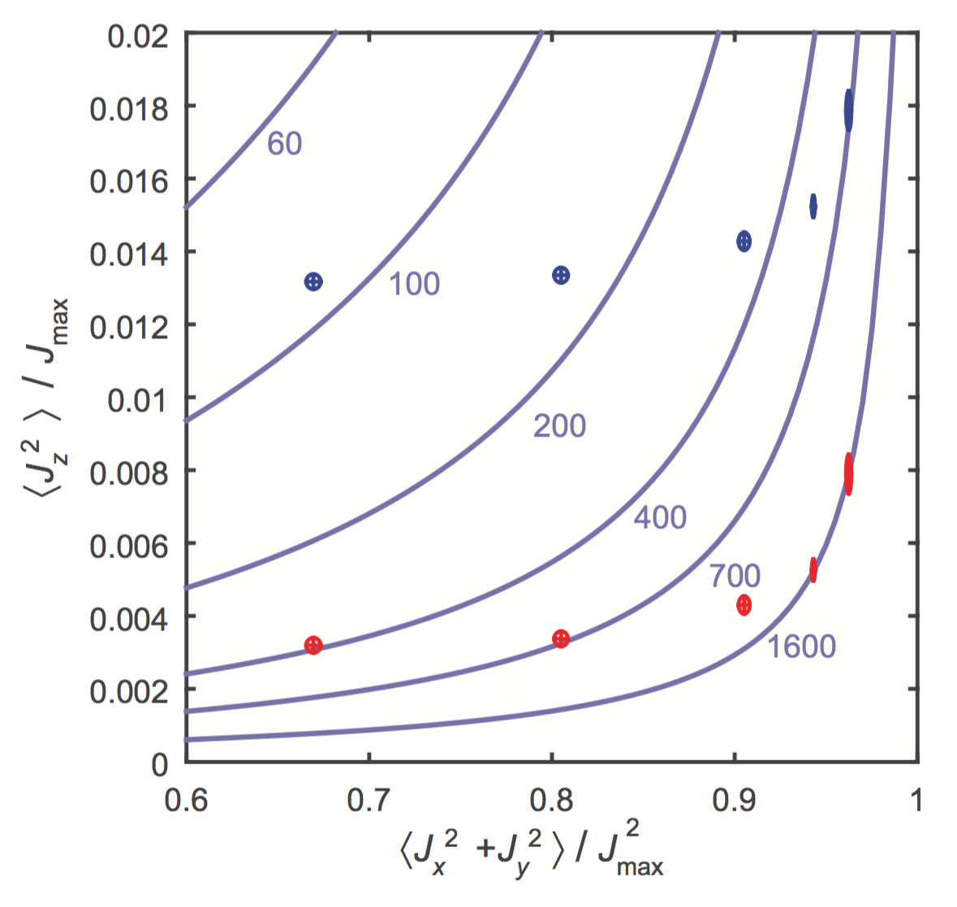
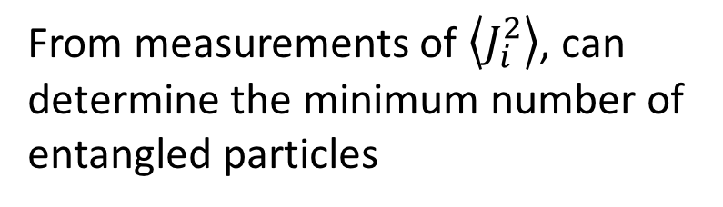
Entanglement depth
From measurements of $\left\langle J_{i}^{2}\right\rangle$, can determine the minimum number of entangled particles
Being below curve on right = at least that many entangled particles
Blue includes small inhomogeneous atom-cavity coupling
Notes:
Best metrological improvement was 5*10^5 atoms, 330(15) entangled atoms
Most entangled 680(35) at π/2 measurement strength
Without inhomogeneity 1605(30) is max
3rd point in each set is max metrological improvement (most entanglement not necessarily greatest metrological improvement)
To get the curves is a constrained optimization problem, given number of particles N and number of entangled particles k, can calculate “surface” of <Ji^2>’s where k is minimum number of entangled particles
These are for 5*10^5 atoms, left to right is decreasing probe power

Slide 10
Conclusions
Achieved 20.1(3) dB squeezing (12 dB maximum previously)
Entangled at least 680(35) atoms
Used squeezed states to improve phase sensitivity of atomic clock
Better single shot readout (147 µrad) than other ultracold atom sensors
Squeezed states prepared here can be released from lattice for precision sensors (anticipate 14.6 dB retrievable squeezing)

